Slide 1
Parallel Computer Memory Architectures

Slide 2
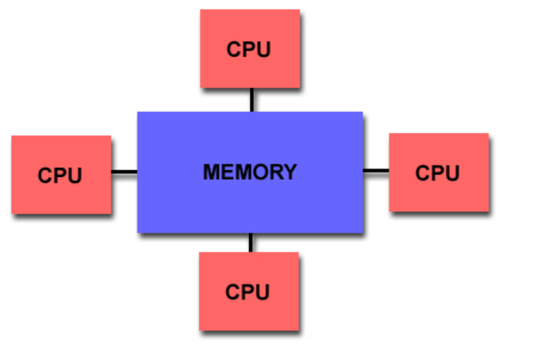
Shared Memory
General Characteristics:
Shared memory parallel computers vary widely, but generally have in common the ability for all processors to access all memory as global address space.

Slide 3
Multiple processors can operate independently but share the same memory resources.
Changes in a memory location effected by one processor are visible to all other processors.
Shared memory machines can be divided into two main classes based upon memory access times: UMA and NUMA.
Uniform Memory Access (UMA):
Most commonly represented today by Symmetric Multiprocessor (SMP) machines
Identical processors
Equal access and access times to memory
Sometimes called CC-UMA - Cache Coherent UMA. Cache coherent means if one processor updates a location in shared memory, all the other processors know about the update. Cache coherency is accomplished at the hardware level.

Slide 4
Non-Uniform Memory Access (NUMA):
Often made by physically linking two or more SMPs
One SMP can directly access memory of another SMP
Not all processors have equal access time to all memories
Memory access across link is slower
If cache coherency is maintained, then may also be called CC-NUMA - Cache Coherent NUMA

Slide 5
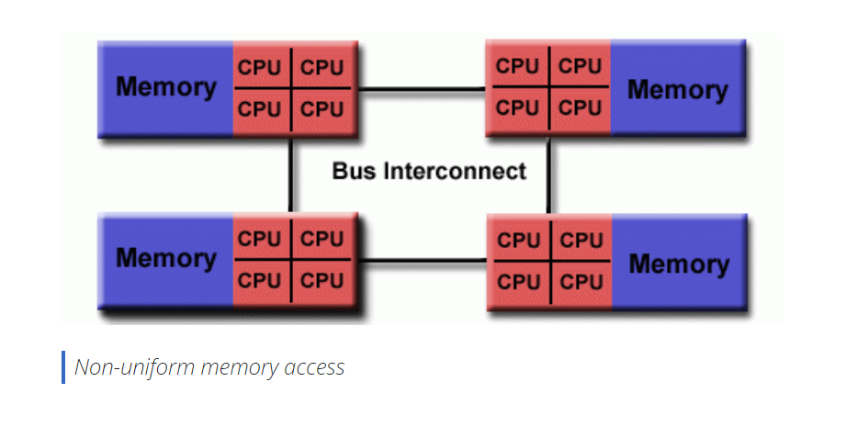

Slide 6
Advantages:
Global address space provides a user-friendly programming perspective to memory
Data sharing between tasks is both fast and uniform due to the proximity of memory to CPUs
Disadvantages:
Primary disadvantage is the lack of scalability between memory and CPUs. Adding more CPUs can geometrically increases traffic on the shared memory-CPU path, and for cache coherent systems, geometrically increase traffic associated with cache/memory management.
Programmer responsibility for synchronization constructs that insure "correct" access of global memory.
Expense: it becomes increasingly difficult and expensive to design and produce shared memory machines with ever increasing numbers of processors.

Slide 7
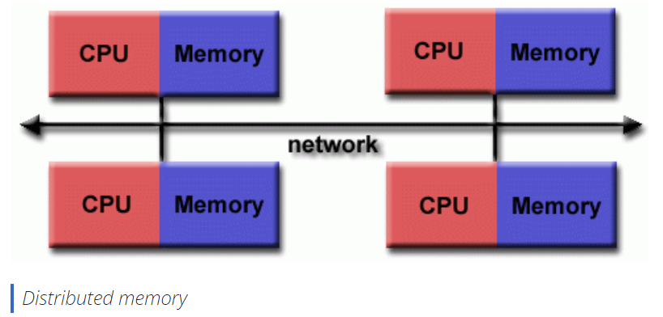
Distributed Memory
General Characteristics:
Like shared memory systems, distributed memory systems vary widely but share a common characteristic. Distributed memory systems require a communication network to connect inter-processor memory.

Slide 8
Processors have their own local memory. Memory addresses in one processor do not map to another processor, so there is no concept of global address space across all processors.
Because each processor has its own local memory, it operates independently. Changes it makes to its local memory have no effect on the memory of other processors. Hence, the concept of cache coherency does not apply.
When a processor needs access to data in another processor, it is usually the task of the programmer to explicitly define how and when data is communicated. Synchronization between tasks is likewise the programmer's responsibility.
The network "fabric" used for data transfer varies widely, though it can can be as simple as Ethernet.

Slide 9
Advantages:
Memory is scalable with number of processors. Increase the number of processors and the size of memory increases proportionately.
Each processor can rapidly access its own memory without interference and without the overhead incurred with trying to maintain cache coherency.
Cost effectiveness: can use commodity, off-the-shelf processors and networking.
Disadvantages:
The programmer is responsible for many of the details associated with data communication between processors.
It may be difficult to map existing data structures, based on global memory, to this memory organization.

Slide 10
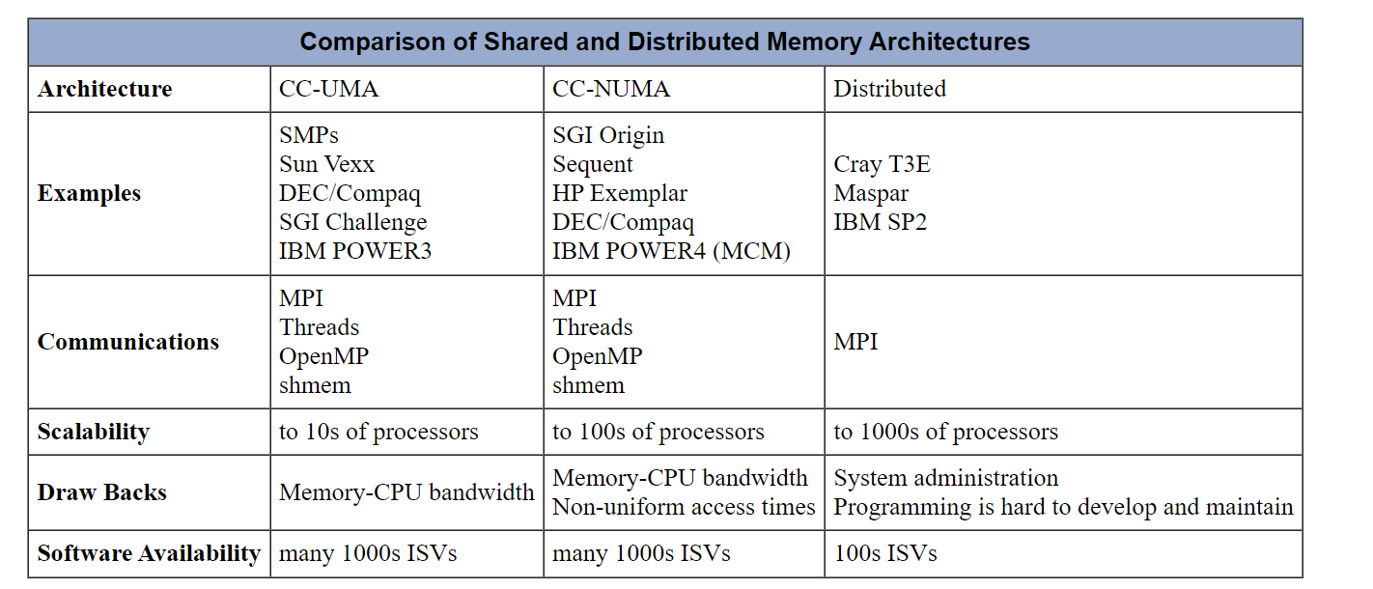

Slide 11
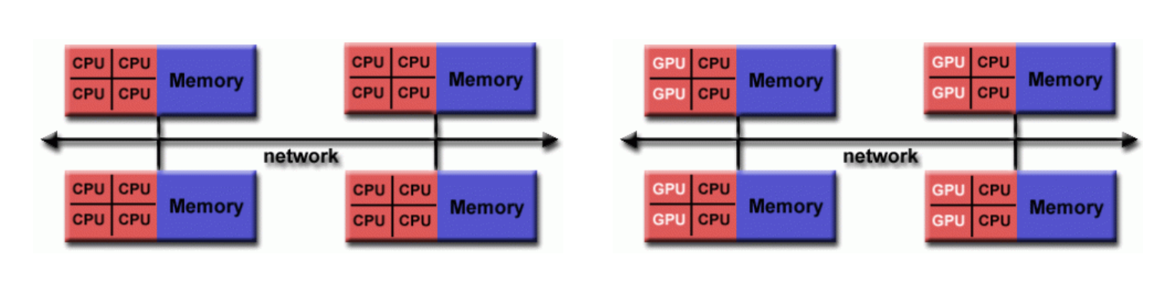
Hybrid Distributed-Shared Memory
The largest and fastest computers in the world today employ both shared and distributed memory architectures.

Slide 12
The shared memory component is usually a cache coherent SMP machine. Processors on a given SMP can address that machine's memory as global.
The distributed memory component is the networking of multiple SMPs. SMPs know only about their own memory - not the memory on another SMP. Therefore, network communications are required to move data from one SMP to another.
Current trends seem to indicate that this type of memory architecture will continue to prevail and increase at the high end of computing for the foreseeable future.
Advantages and Disadvantages:
Whatever is common to both shared and distributed memory architectures.
Increased scalability is an important advantage
Increased programmer complexity is an important disadvantage

